Slide 1
PEFT: Reparameterized Models, LoRA, DyLoRA, QLoRA
Plaban Kumar Bhowmick
Department of AI
plaban@ai.iitkgp.ac.in

Slide 2
Reparameterization
Improving the training efficiency and performance of a model by transforming its parameters
Low-rank parameterization
constructing a low-rank learnable parameter matrix to adapt to specific downstream tasks
Training time: only the low-rank parameter matrix is fine-tuned
Inference time: learned matrix is combined with the pretrained parameters

Slide 3
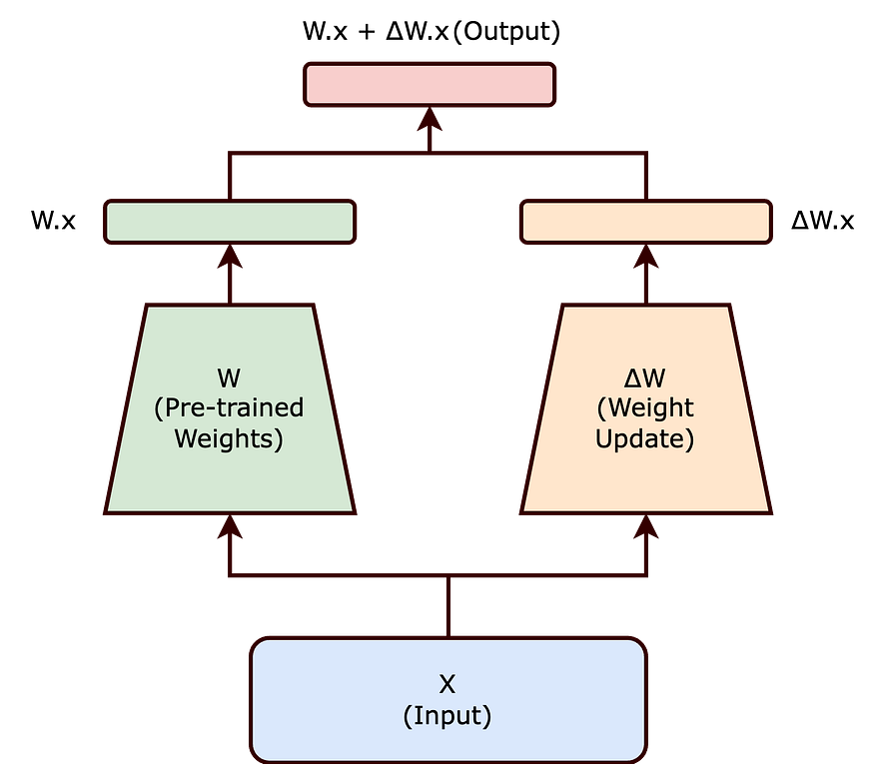
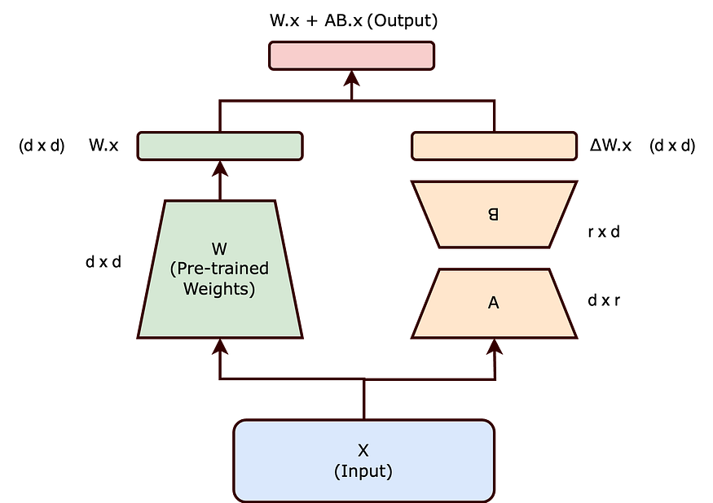
Low-Rank Adaptation (LoRA)
The learned over-parametrized models reside on a low intrinsic dimension.
Change in weights during model adaptation also has a low “intrinsic rank”.

Slide 4
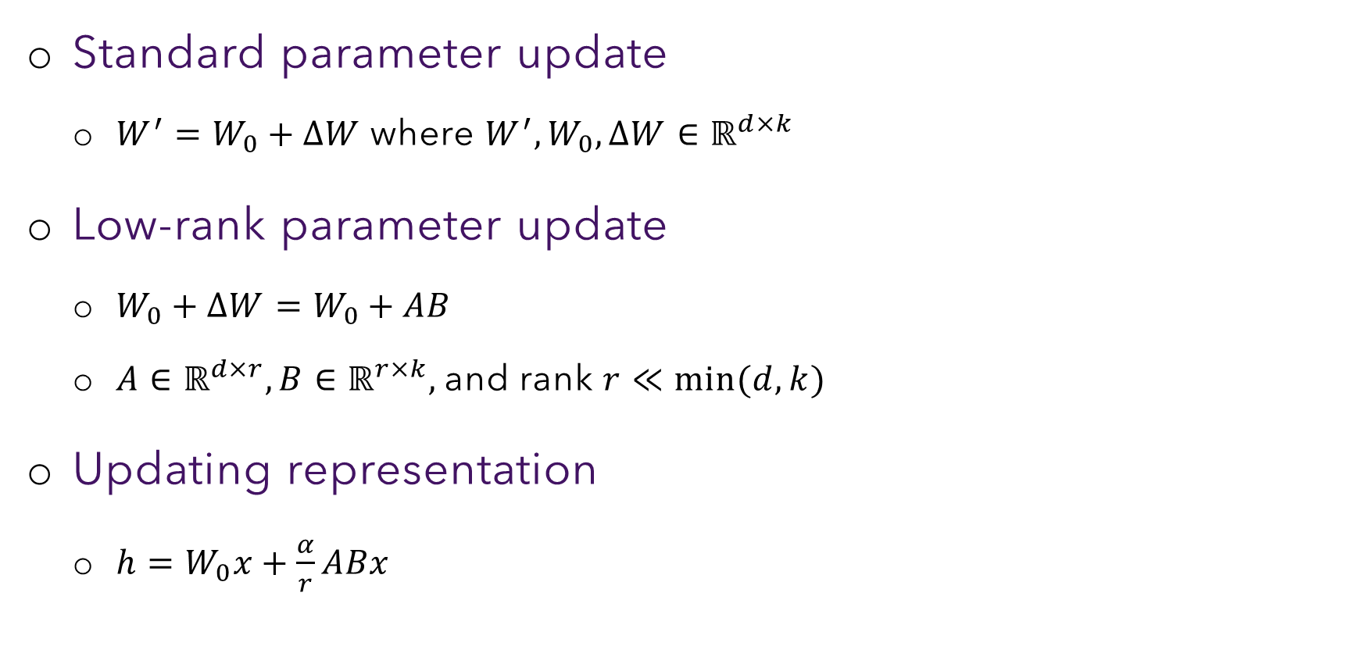
Parameter Update
Standard parameter update
$W^{′}=W_{0}+ΔW$ where $W^{′}, W_{0}, ΔW∈ℝ^{d×k}$
Low-rank parameter update
$W_{0}+ΔW=W_{0}+AB$
$A∈ℝ^{d×r}, B∈ℝ^{r×k},$ and rank $r≪\min{(d,k)}$
Updating representation
$h=W_{0}x+\frac{α}{r}ABx$

Slide 5
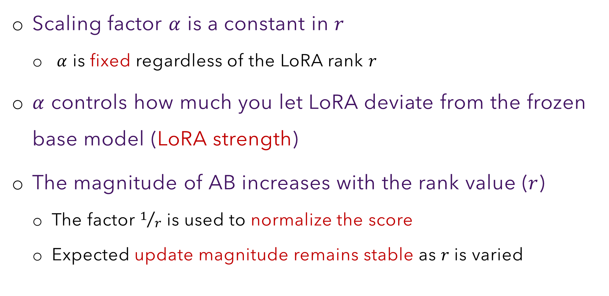
Some Details
Scaling factor $α$ is a constant in $r$
$α$ is fixed regardless of the LoRA rank 𝑟
$α$ controls how much you let LoRA deviate from the frozen base model (LoRA strength)
The magnitude of AB increases with the rank value ($r$)
The factor $1/r$ is used to normalize the score
Expected update magnitude remains stable as 𝑟 is varied

Slide 6
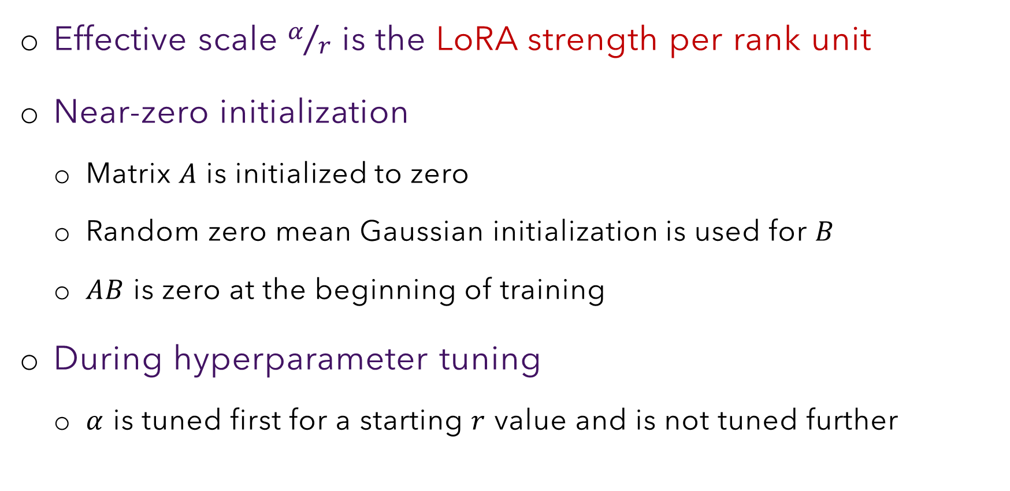
Some Details
Effective scale $α/r$ is the LoRA strength per rank unit
Near-zero initialization
Matrix $A$ is initialized to zero
Random zero mean Gaussian initialization is used for $B$
$AB$ is zero at the beginning of training
During hyperparameter tuning
$α$ is tuned first for a starting $r$ value and is not tuned further

Slide 7
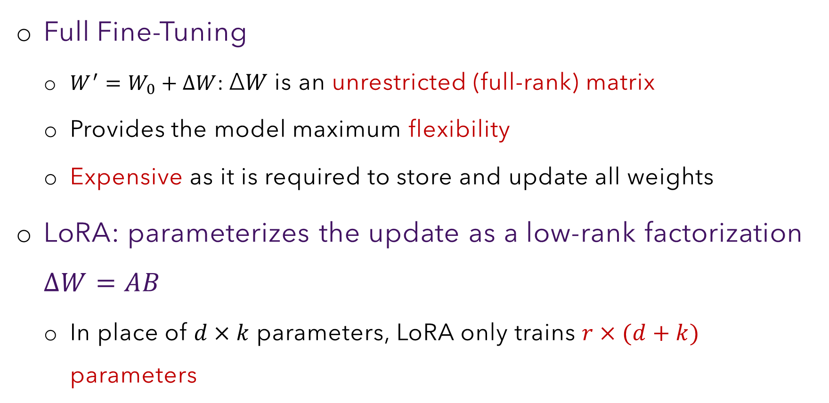
LoRA is a Generalization of Full Fine-Tuning
Full Fine-Tuning
$W^{′}=W_{0}+ΔW$: Δ𝑊 is an unrestricted (full-rank) matrix
Provides the model maximum flexibility
Expensive as it is required to store and update all weights
LoRA: parameterizes the update as a low-rank factorization $ΔW=AB$
In place of $d×k$ parameters, LoRA only trains $r×(d+k)$ parameters

Slide 8
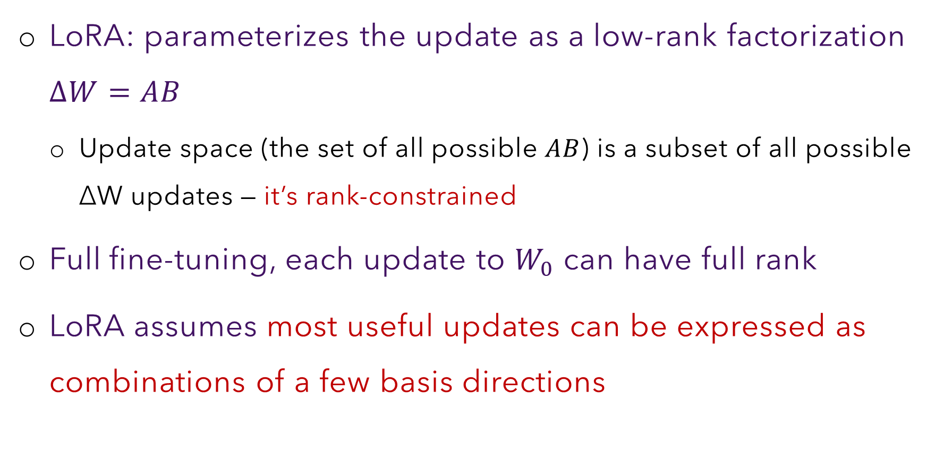
LoRA is a Generalization of Full Fine-Tuning
LoRA: parameterizes the update as a low-rank factorization $ΔW=AB$
Update space (the set of all possible $AB$) is a subset of all possible ΔW updates — it’s rank-constrained
Full fine-tuning, each update to $W_{0}$ can have full rank
LoRA assumes most useful updates can be expressed as combinations of a few basis directions

Slide 9
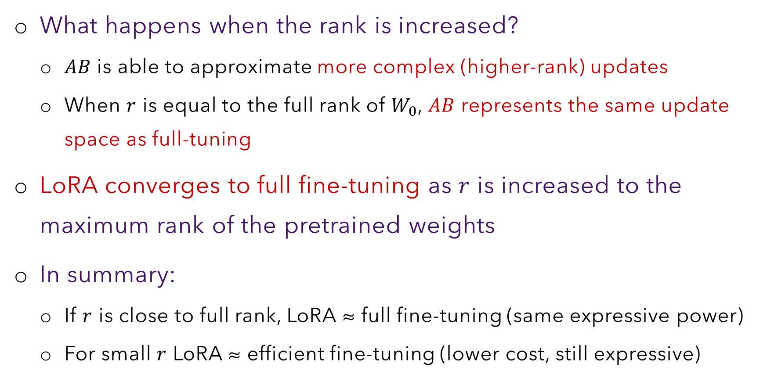
LoRA is a Generalization of Full Fine-Tuning
What happens when the rank is increased?
$AB$ is able to approximate more complex (higher-rank) updates
When $r$ is equal to the full rank of $W_{0}$, $AB$ represents the same update space as full-tuning
LoRA converges to full fine-tuning as $r$ is increased to the maximum rank of the pretrained weights
In summary:
If $r$ is close to full rank, LoRA ≈ full fine-tuning (same expressive power)
For small $r$ LoRA ≈ efficient fine-tuning (lower cost, still expressive)

Slide 10
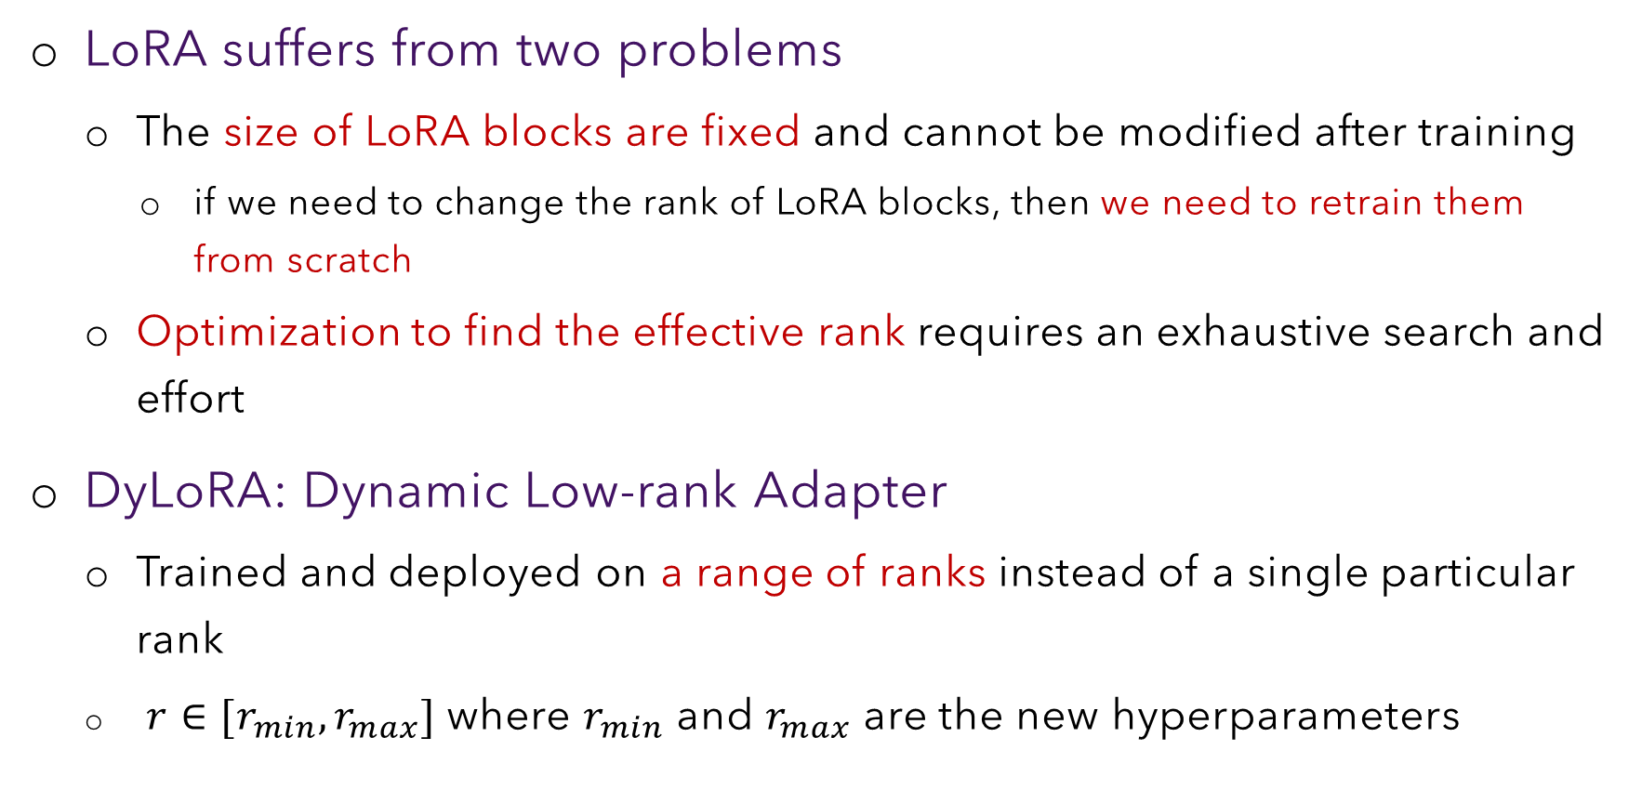
Dynamic Low-rank Adaptation
LoRA suffers from two problems
The size of LoRA blocks are fixed and cannot be modified after training
if we need to change the rank of LoRA blocks, then we need to retrain them from scratch
Optimization to find the effective rank requires an exhaustive search and effort
DyLoRA: Dynamic Low-rank Adapter
Trained and deployed on a range of ranks instead of a single particular rank
$r∈[r_{min}, r_{max}]$ where $r_{min}$ and $r_{max}$ are the new hyperparameters

Slide 11
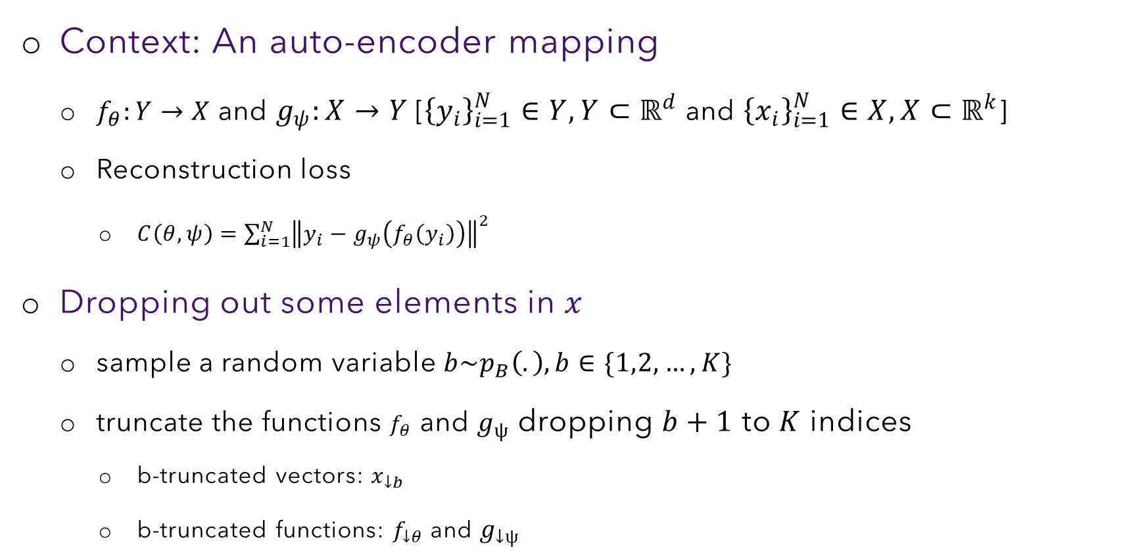
Nested Dropout
Context: An auto-encoder mapping
$f_{θ}:Y→X$ and $g_{ψ}:X→Y$ [${\left\{y_{i}\right\}}_{i=1}^{N}∈Y, Y⊂ℝ^{d}$ and ${\left\{x_{i}\right\}}_{i=1}^{N}∈X, X⊂ℝ^{k}$]
Reconstruction loss
$C\left(θ, ψ\right)=\sum_{i=1}^{N}{{\left\|y_{i}−g_{ψ}\left(f_{θ}\left(y_{i}\right)\right)\right\|}^{2}}$
Dropping out some elements in $x$
sample a random variable $b\sim p_{B}\left(.\right), b∈\{1,2, …, K\}$
truncate the functions $f_{θ}$ and $g_{ψ}$ dropping $b+1$ to $K$ indices
b-truncated vectors: $x_{↓b}$
b-truncated functions: $f_{↓θ}$ and $g_{↓ψ}$

Slide 12
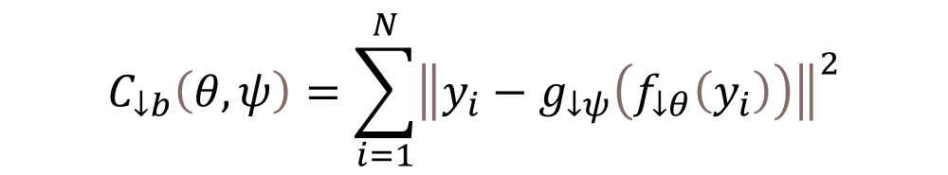
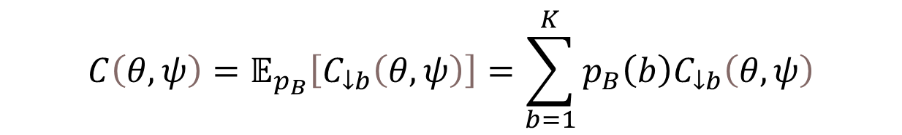

Nested Dropout
$$C\left(θ, ψ\right)=𝔼_{p_{B}}\left[C_{↓b}\left(θ, ψ\right)\right]=\sum_{b=1}^{K}{p_{B}\left(b\right)C_{↓b}\left(θ, ψ\right)}$$
$$C_{↓b}\left(θ, ψ\right)=\sum_{i=1}^{N}{{\left\|y_{i}−g_{↓ψ}\left(f_{↓θ}\left(y_{i}\right)\right)\right\|}^{2}}$$
$$\left(θ^{∗}, ψ^{∗}\right)=arg\min_{θ,ψ}{C\left(θ , ψ\right)}$$

Slide 13
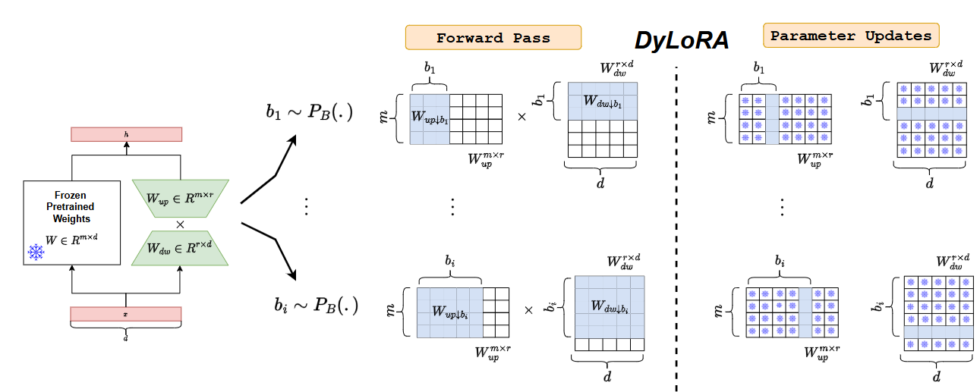
DyLoRA Process

Slide 14
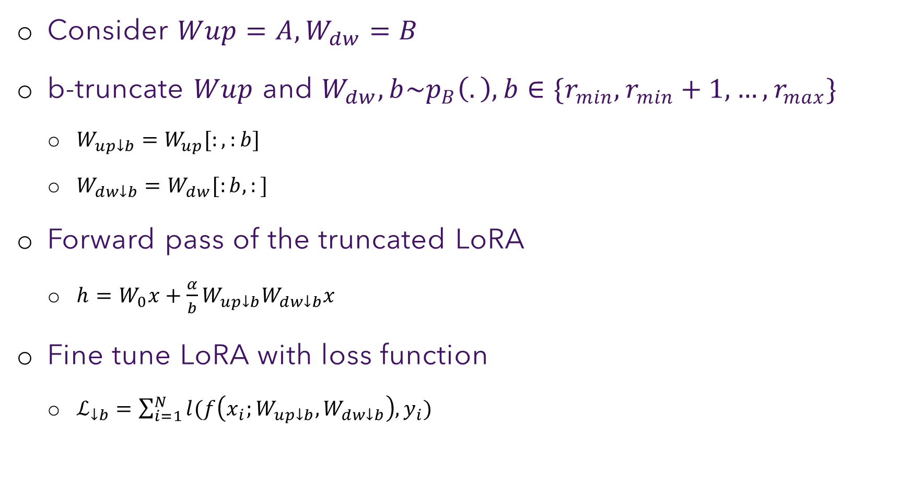
DyLoRA Process
Consider $Wup=A, W_{dw}=B$
b-truncate $Wup$ and $W_{dw}, b\sim p_{B}\left(.\right), b∈\{r_{min}, r_{min}+1, …, r_{max}\}$
$W_{up↓b}=W_{up}[:,:b]$
$W_{dw↓b}=W_{dw}[:b,:]$
Forward pass of the truncated LoRA
$h=W_{0}x+\frac{α}{b}W_{up↓b}W_{dw↓b}x$
Fine tune LoRA with loss function
$ℒ_{↓b}=\sum_{i=1}^{N}{l(f\left(x_{i};W_{up↓b}, W_{dw↓b}\right),y_{i})}$

Slide 15
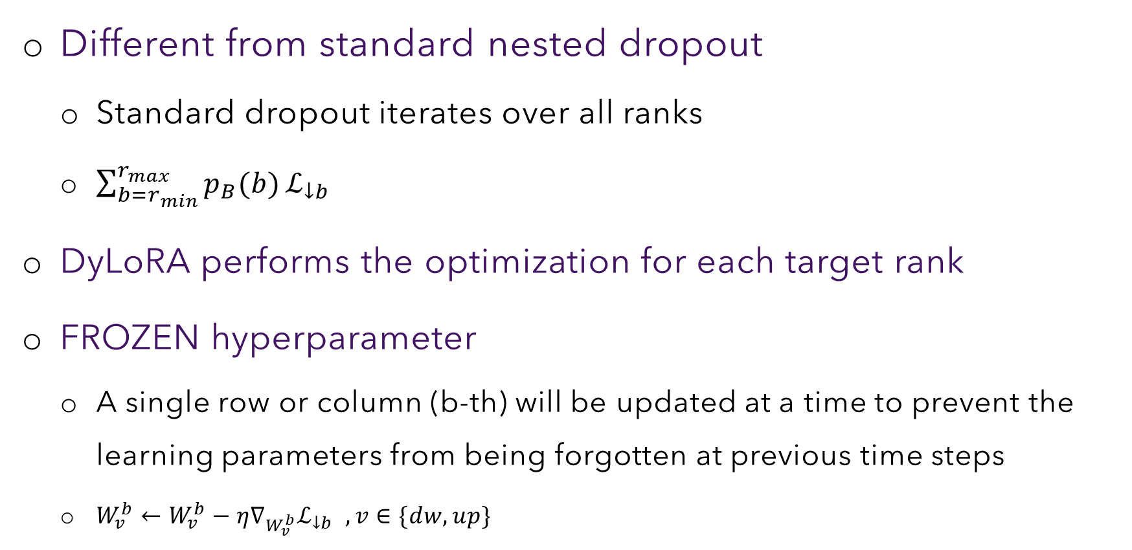
DyLoRA Process
Different from standard nested dropout
Standard dropout iterates over all ranks
$\sum_{b=r_{min}}^{r_{max}}{p_{B}(b)}ℒ_{↓b}$
DyLoRA performs the optimization for each target rank
FROZEN hyperparameter
A single row or column (b-th) will be updated at a time to prevent the learning parameters from being forgotten at previous time steps
$W_{v}^{b}←W_{v}^{b}−η∇_{W_{v}^{b}}ℒ_{↓b} , v∈\{dw, up\}$

Slide 16
Quantized PEFT

Slide 17
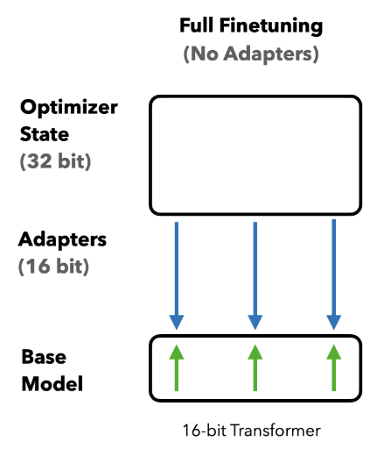
Cost of Fine-tuning an LLM
Weight: 2 bytes
Weight gradients: 2 bytes
Optimizer state: 8 bytes
70B model → 840GB of GPU memory → 18x data center GPUs
*Fine-tuning cost per parameter

Slide 18
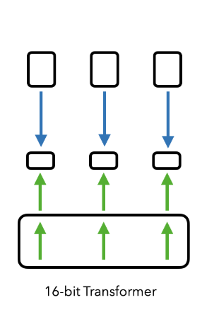
Cost of Fine-tuning an LLM
Weight: 16 bits
Weight gradients: ~0.4bits
Optimizer state: ~0.8bits
Adapter weights: ~0.4bits
70B model → 154GB of GPU memory → 4x data center GPUs
LoRA
*Fine-tuning cost per parameter

Slide 19
Can we fit the LLMs in a Single GPU?
Quantization: aims at improving computational efficiency and reducing memory usage
What is quantization?
Discretizing an input from a representation that holds more information to a representation with less information
Taking a data type (32-bit float) with more bits and converting it to fewer bits (8-bit integer)

Slide 20
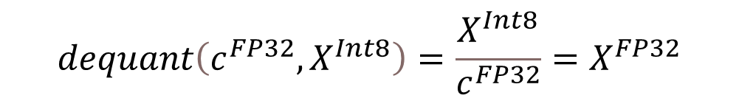
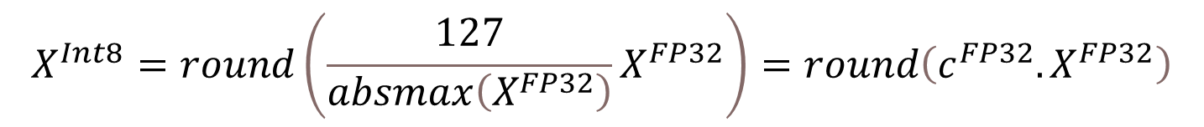
Quantization
Quantizing a 32-bit Floating Point (FP32) tensor into a Int8 tensor with range [−127, 127]
$$X^{Int8}=round\left(\frac{127}{absmax\left(X^{FP32}\right)}X^{FP32}\right)=round\left(c^{FP32}.X^{FP32}\right)$$
c is called the quantization constant
$$dequant\left(c^{FP32}, X^{Int8}\right)=\frac{X^{Int8}}{c^{FP32}}=X^{FP32}$$

Slide 21
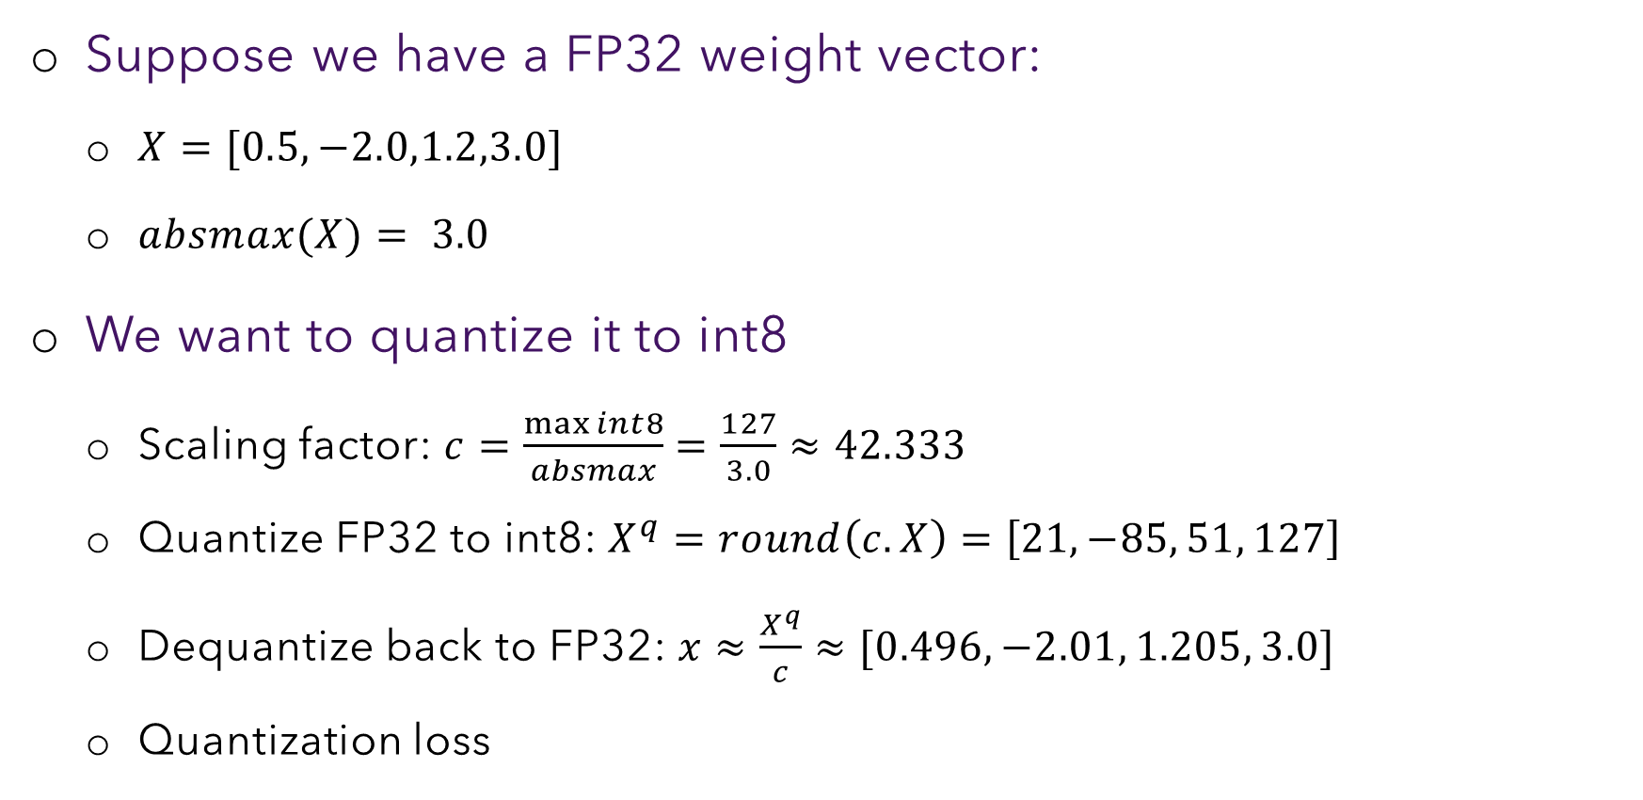
Uniform Quantization: Example
Suppose we have a FP32 weight vector:
$X=[0.5,−2.0,1.2,3.0]$
$absmax(X)= 3.0$
We want to quantize it to int8
Scaling factor: $c=\frac{\max{int}8}{absmax}=\frac{127}{3.0}≈42.333$
Quantize FP32 to int8: $X^{q}=round\left(c.X\right)=\left[21, −85, 51, 127\right]$
Dequantize back to FP32: $x≈\frac{X^{q}}{c}≈[0.496, −2.01, 1.205, 3.0]$
Quantization loss

Slide 22
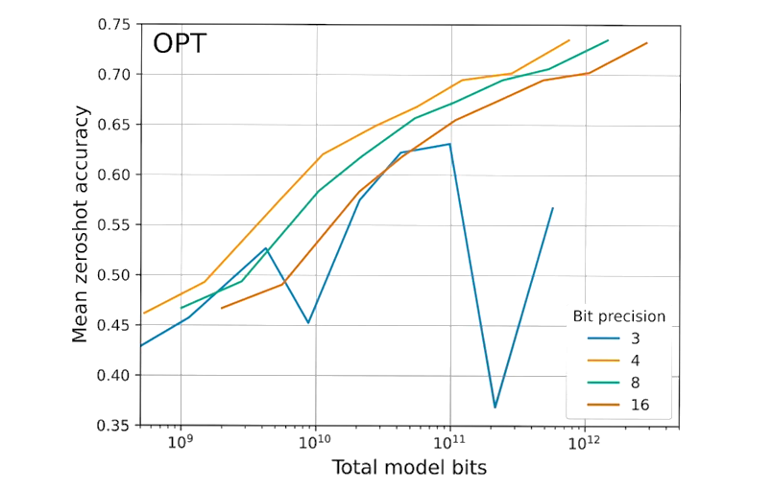
Does Quantization Help?

Slide 23
Issue with Vanilla (Uniform) Quantization
What happens a very small fragments of the weights have very high value (outlier)
Can't discard the outliers
Uniform quantization allocates same sized bins
even if some bins are near empty (outliers)
We may want allocate lesser number of bits to such ranges and assign the surplus bits where the values are dense.

Slide 24
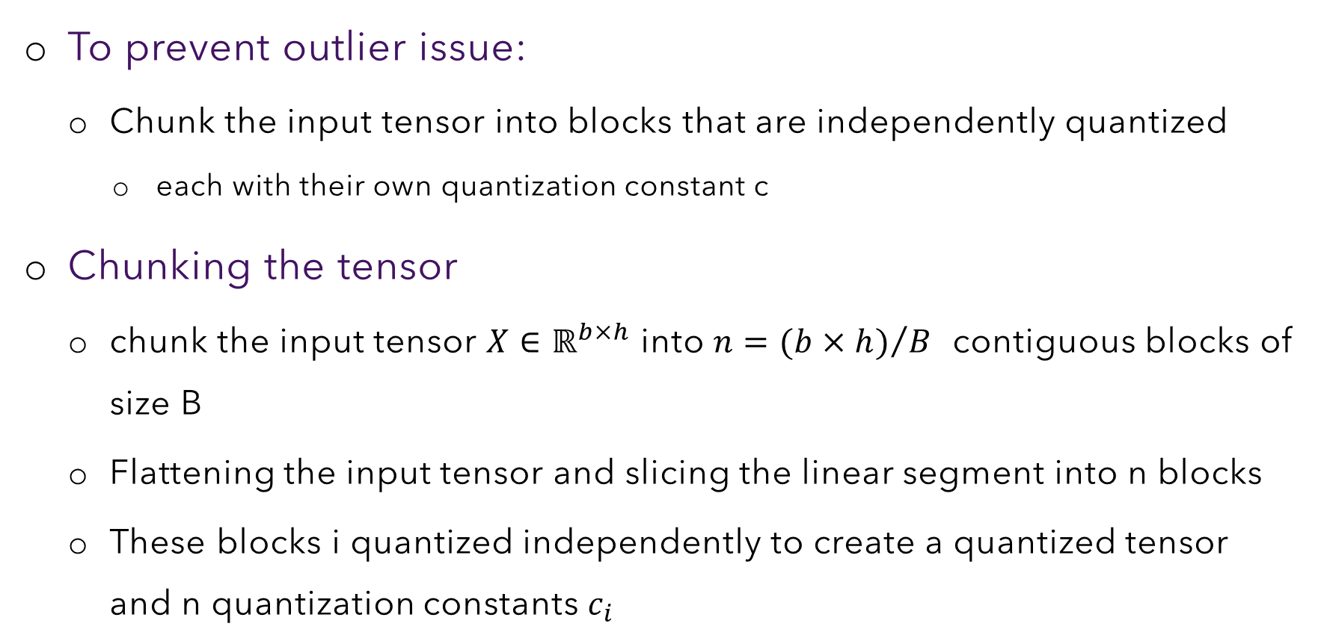
Issue with Vanilla (Uniform) Quantization
To prevent outlier issue:
Chunk the input tensor into blocks that are independently quantized
each with their own quantization constant c
Chunking the tensor
chunk the input tensor $X∈ℝ^{b×h}$ into $n={(b×h)}/B$ contiguous blocks of size B
Flattening the input tensor and slicing the linear segment into n blocks
These blocks i quantized independently to create a quantized tensor and n quantization constants $c_{i}$

Slide 25
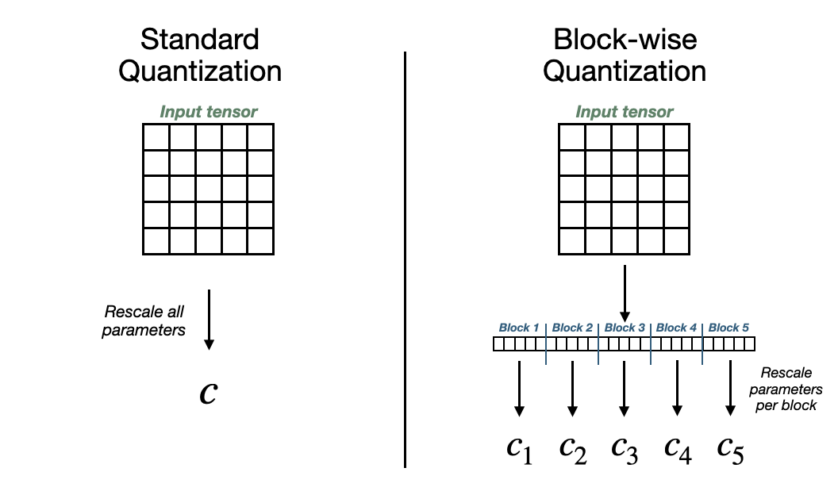


Chunking-based Quantization
Need to store only one value $c$
Need to store $n$ values

Slide 26
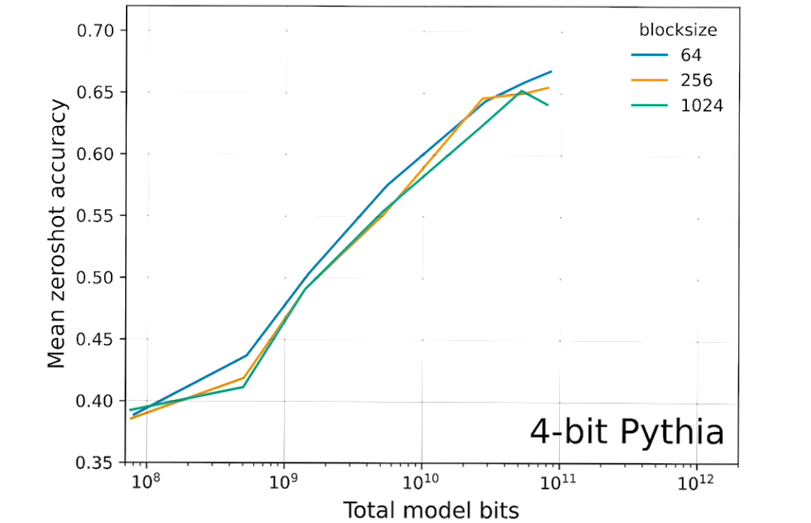
Chunking Helps

Slide 27
Three Core Ideas in QLoRA
New data type
4-bit NormalFloat Quantization
Double quantization
To reduce memory requirement to store the block-based quantization constants
Paged optimization
Helps with GPU runs out of memory

Slide 28
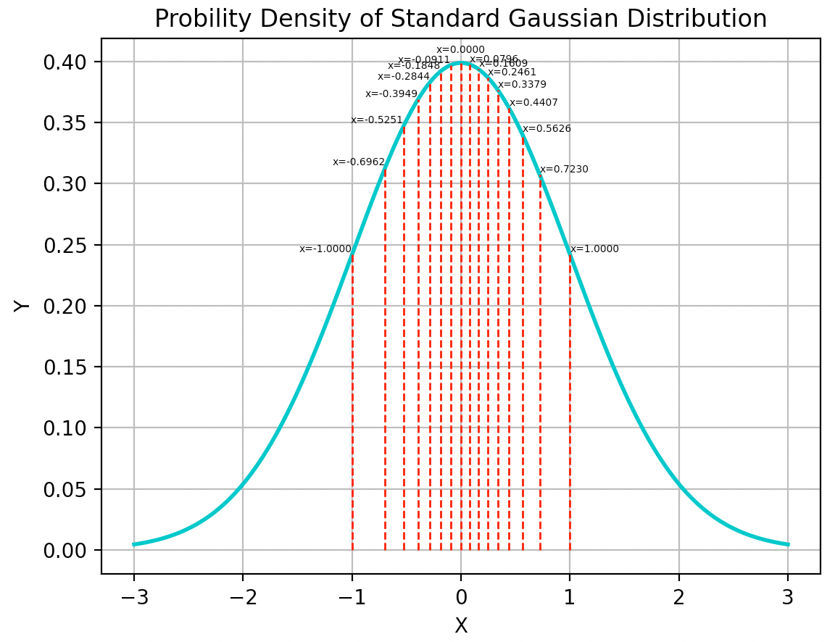
4-bit NormalFloat Quantization
Quantile Quantization
ensures each quantization bin has an equal number of values assigned from the input tensor
LLM weights are typically normally distributed
Have more precision near the mean (zero)
Reduce precision for the value ranges that
moves away from mean (zero)
Create more, finer quantization levels near zero
and fewer, coarser levels in the tails

Slide 29
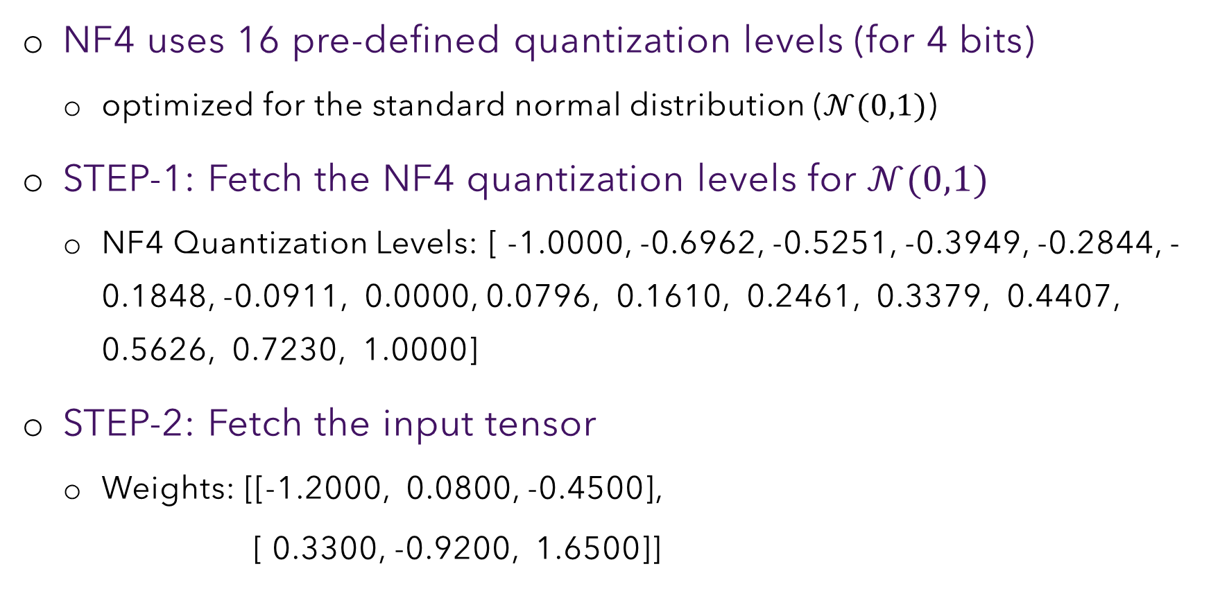
NF4 Quantization Steps
NF4 uses 16 pre-defined quantization levels (for 4 bits)
optimized for the standard normal distribution ($𝒩(0,1)$)
STEP-1: Fetch the NF4 quantization levels for $𝒩(0,1)$
NF4 Quantization Levels: [ -1.0000, -0.6962, -0.5251, -0.3949, -0.2844, -0.1848, -0.0911, 0.0000, 0.0796, 0.1610, 0.2461, 0.3379, 0.4407, 0.5626, 0.7230, 1.0000]
STEP-2: Fetch the input tensor
Weights: [[-1.2000, 0.0800, -0.4500],
[ 0.3300, -0.9200, 1.6500]]

Slide 30
NF4 Quantization Steps
STEP-3: Normalize the Tensor
Normalization factor (absmax): 1.6500
Normalized Tensor: [[-0.7273, 0.0485, -0.2727],
[ 0.2000, -0.5576, 1.0000]]

Slide 31
NF4 Quantization Steps
STEP-4: Quantize to NF4
Original Weight | Normalized | Closest NF4 value | NF4 Level
-1.2000 | -0.727 | -0.696 | 1
0.0800 | 0.048 | 0.080 | 8
-0.4500 | -0.273 | -0.285 | 4
0.3300 | 0.200 | 0.161 | 9
-0.9200 | -0.558 | -0.525 | 2
1.6500 | 1.000 | 1.000 | 15

Slide 32
NF4 Quantization Steps
STEP-5: Pack 4-bit indices for Storage
Since we can't actually store individual 4-bit values, we pack 2 indices in a byte.
Quantized Indices (4-bit): [1, 8, 4, 9, 2, 15]
Packed data (bytes): [24, 73, 47]
Memory saving
Original memory: 24 bytes
Quantized memory: 3 bytes (packed 4-bit indices)
Plus absmax (4 bytes): 4 bytes
Total quantized: 7 bytes
Memory reduction: 70.8%

Slide 33
NF4 Quantization Steps
STEP-6: Dequantize Back to Float
Map level codes to NF4 values
Dequantize by multiplying with absmax
level 1 → NF4 value -0.696 → dequantized value: -0.696x1.65= -1.1.49
Original | Dequantized | Error
-1.200 | -1.149 | 0.051
0.080 | 0.131 | 0.051
-0.450 | -0.469 | 0.019
0.330 | 0.266 | 0.064
-0.920 | -0.866 | 0.054
1.650 | 1.650 | 0.000

Slide 34
Double Quantization
Block-based quantization is required for handling outliers
Small block size is preferable for precise 4-bit quantization
However, the quantization constants add to the storage requirement
Consider a 32-bit quantization constant and a block-size 64
Add 32/64=0.5 bits per parameter
Each block adds 0.5 bits per parameter
Solution: Double quantization

Slide 35
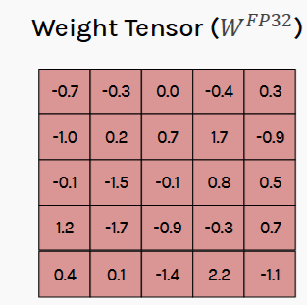
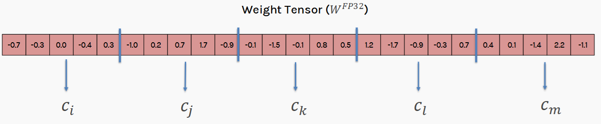
Double Quantization
https://harvard-iacs.github.io/2024-AC215/assets/lectures/lecture9/L09-FineTuning.pdf

Slide 36
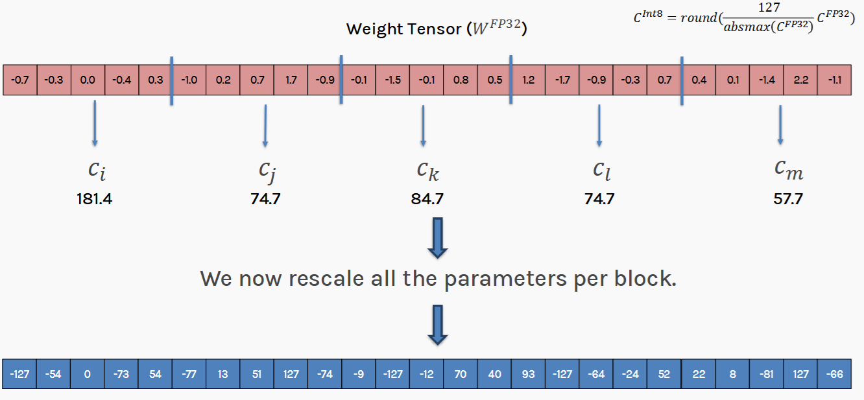

Double Quantization
Rescaled Weight Vector ($W^{Int8}$)

Slide 37
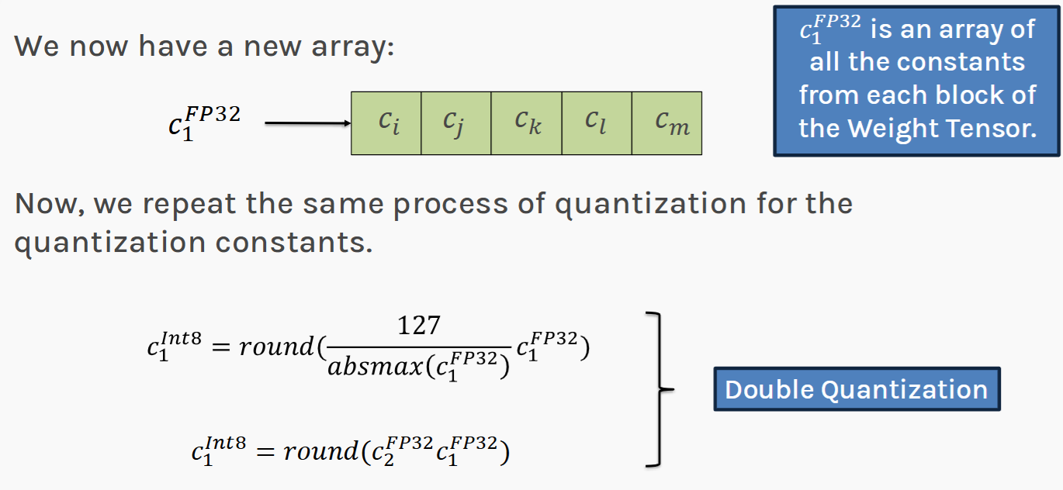
Double Quantization

Slide 38
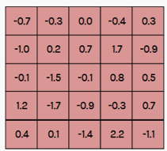
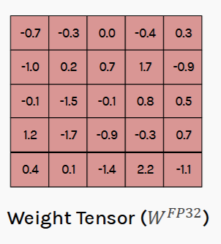
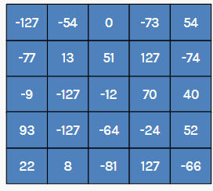






Double Quantization
25x4=100 Bytes
No Quantization
+
Non-Block
$$C_{1}^{FP32}$$
29 Bytes
4 Bytes
25x1=25 Bytes
Block-based, Single Quantization
+
Block-based, Double Quant
45 Bytes
$$C_{1}^{FP32}$$
5x4=20 Bytes
+
+
$$C_{2}^{FP32}$$
34 Bytes
$$C_{1}^{Int8}$$
5x1=5 Bytes
4 Bytes

Slide 39
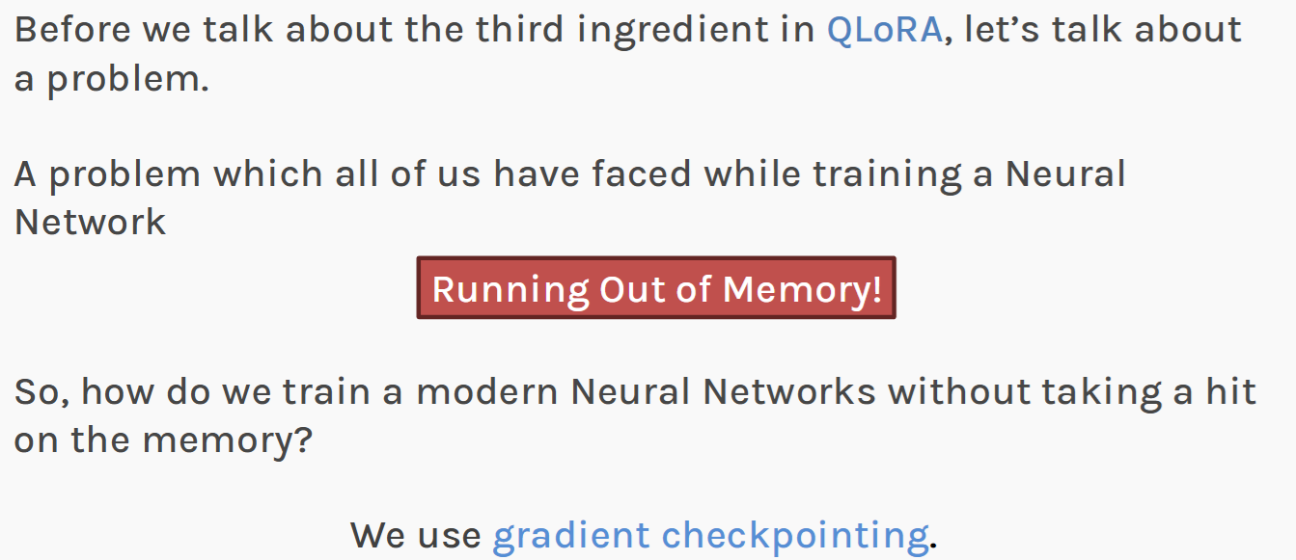
GPU Out of Memory

Slide 40
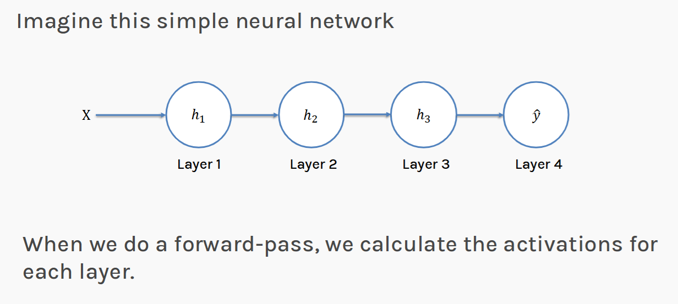
Gradient Checkpointing

Slide 41
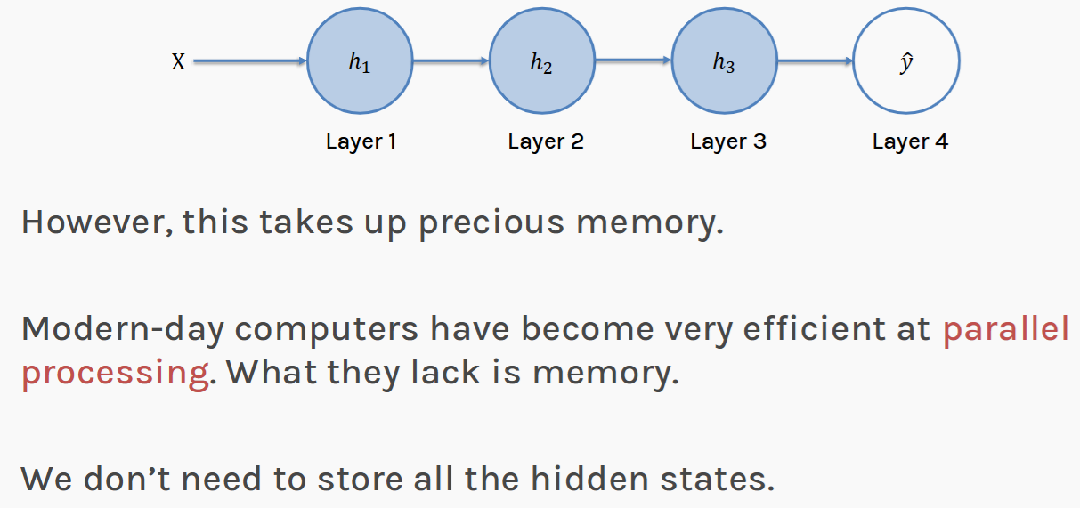
Gradient Checkpointing

Slide 42
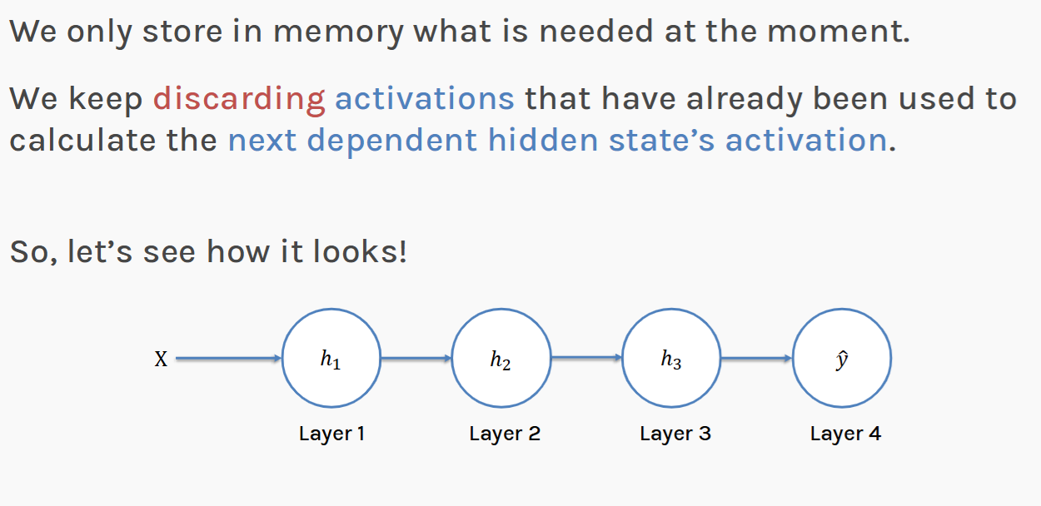
Gradient Checkpointing

Slide 43
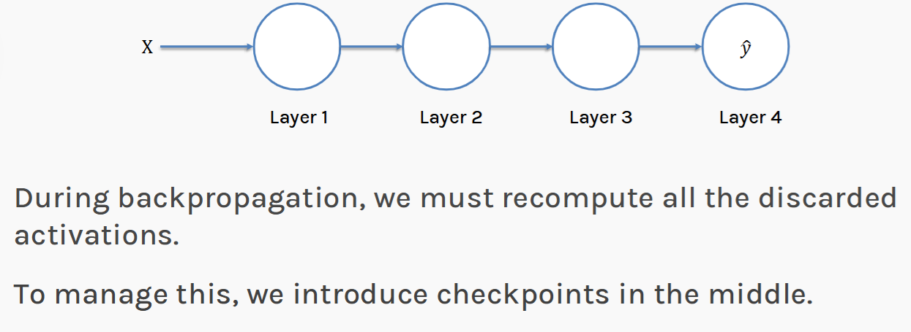
Gradient Checkpointing

Slide 44
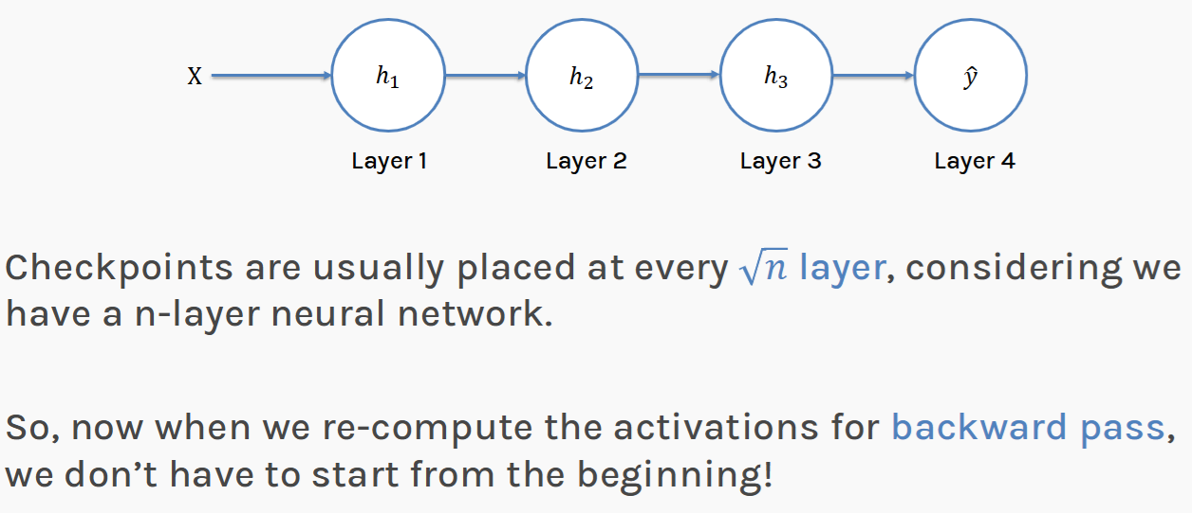
Gradient Checkpointing

Slide 45
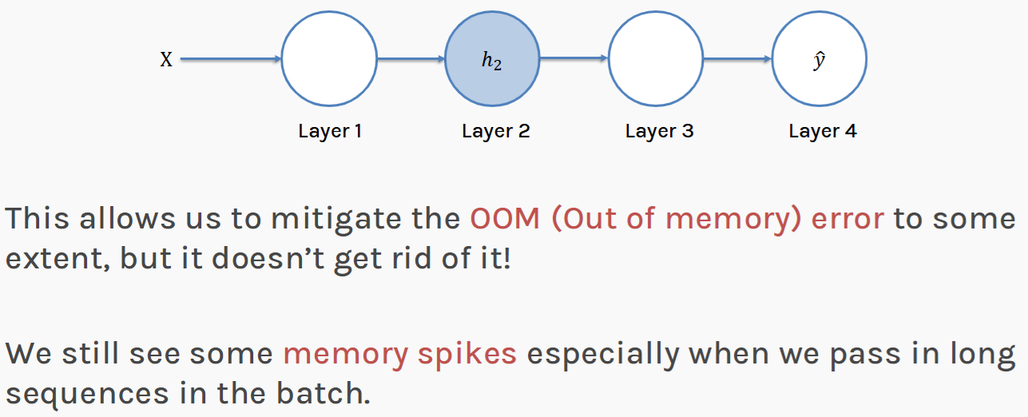
Gradient Checkpointing

Slide 46
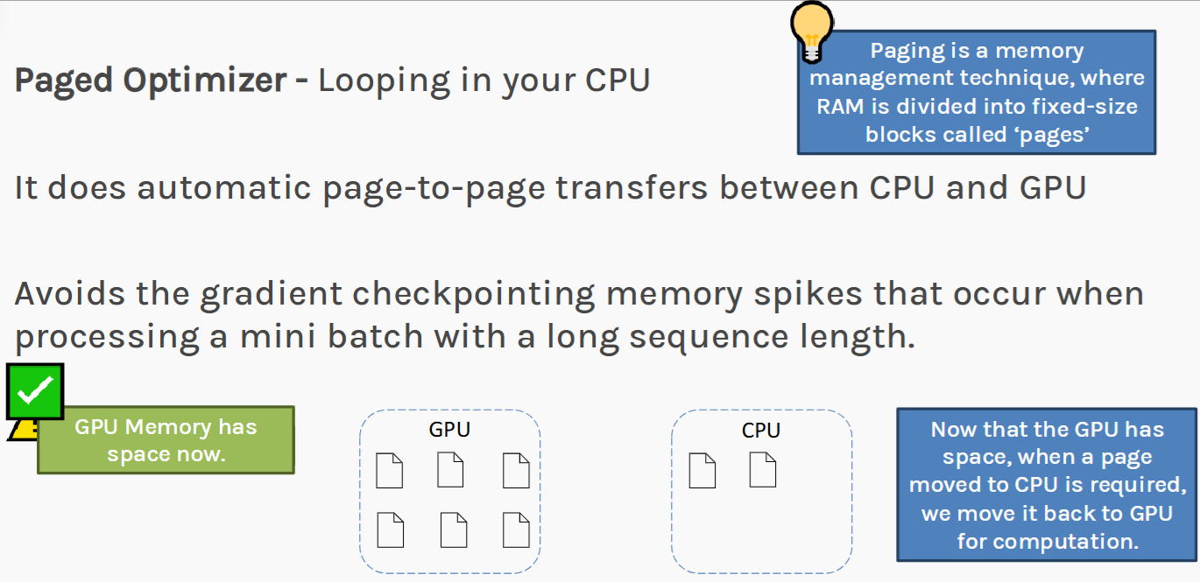
Paged Optimizer

Slide 47
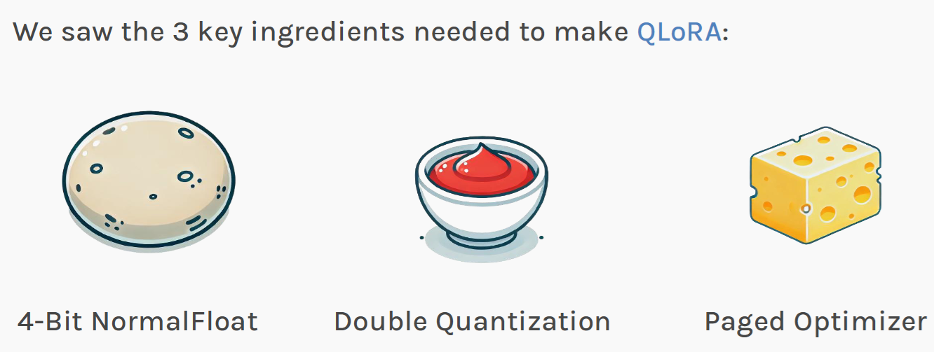
QLoRA: Ingredients

Slide 48
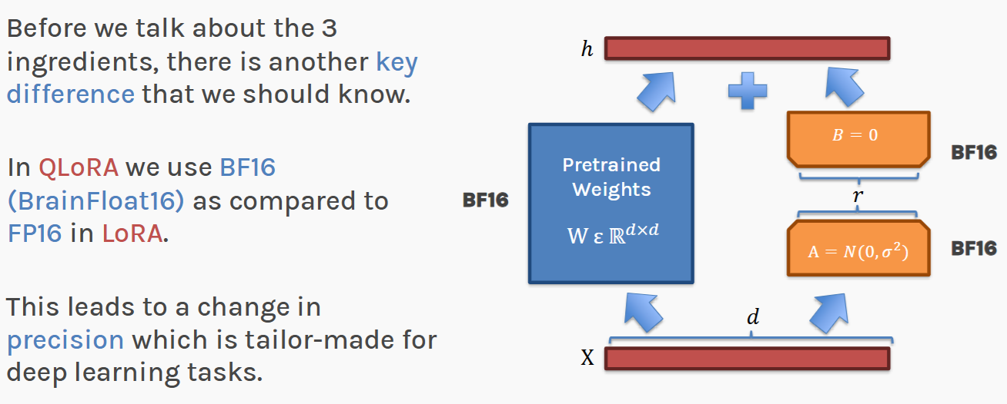
Putting it all together

Slide 49
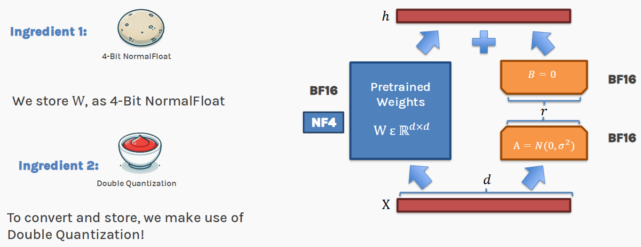
Putting it all together

Slide 50
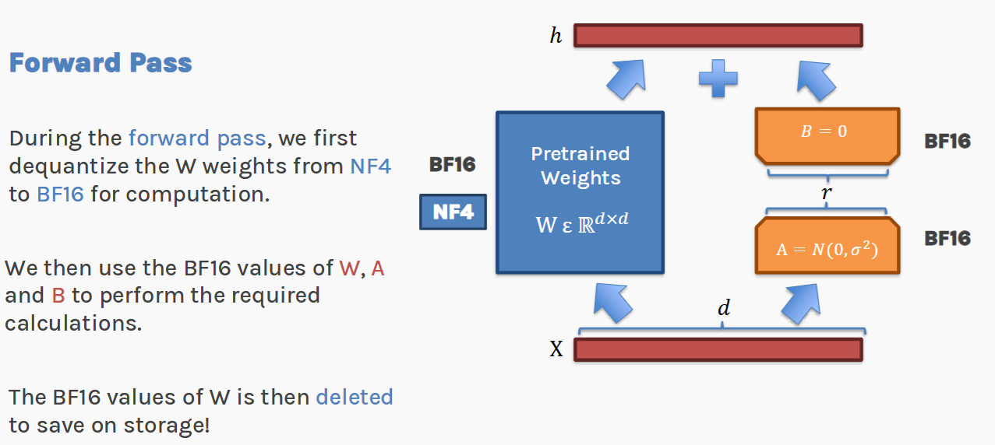
Putting it all together

Slide 51
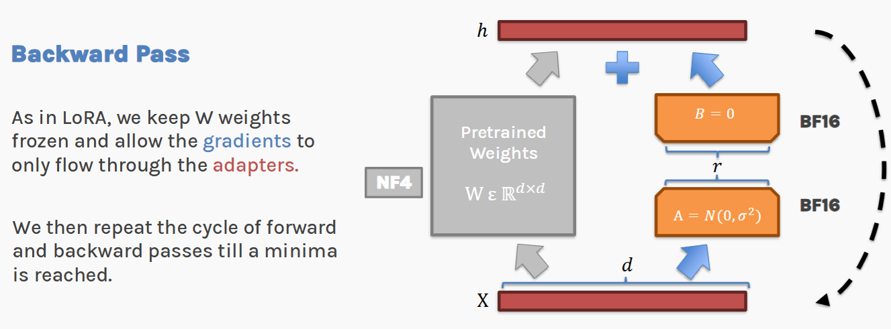
Putting it all together

Slide 52
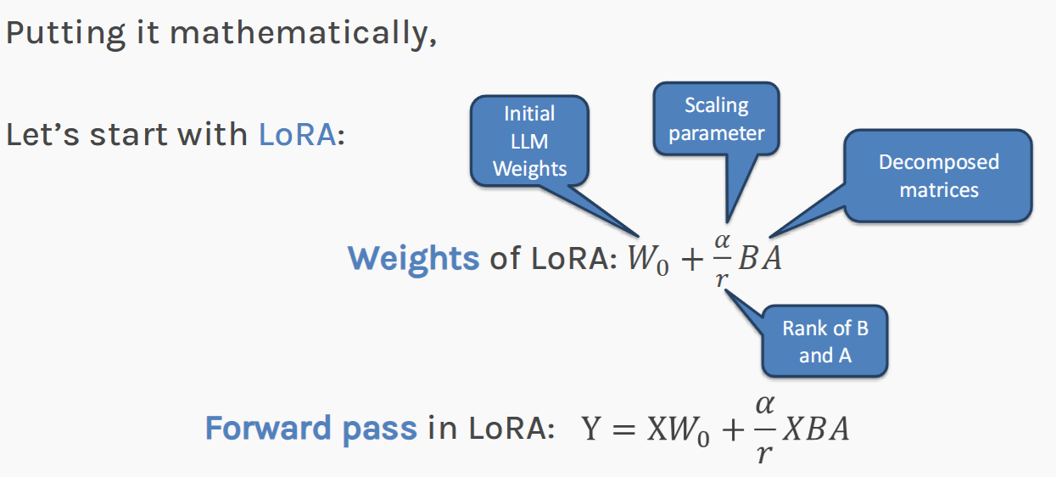
Putting it all together

Slide 53
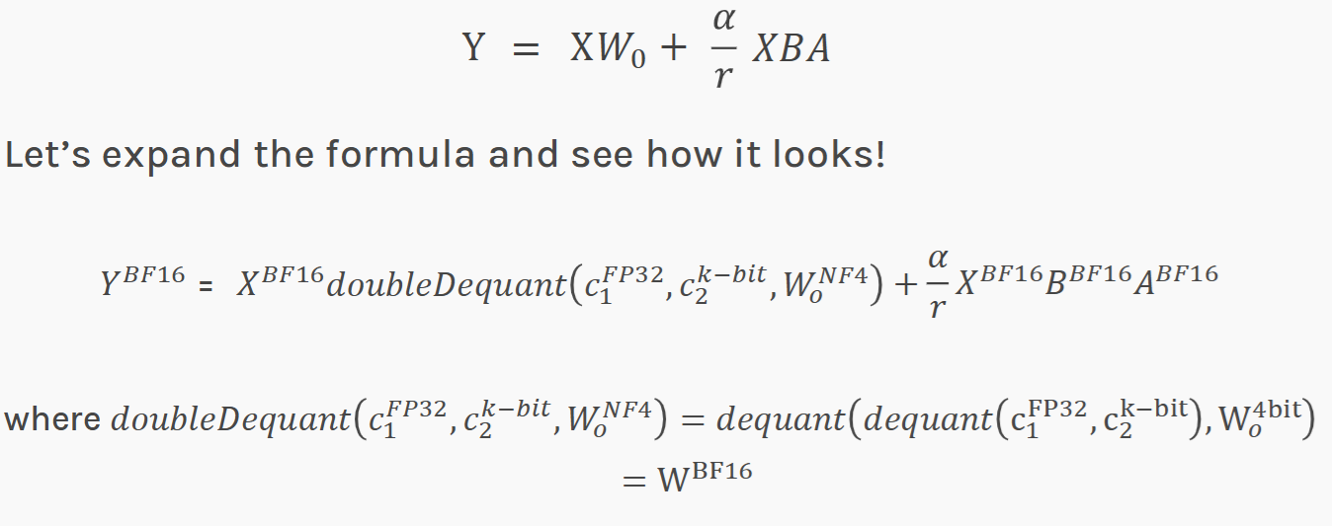
Putting it all together

Slide 54
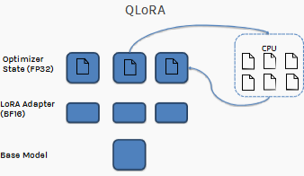
Can we fit the LLMs in a Single GPU?
Weight: 4 bits
Weight gradients: ~0.4bits
Optimizer state: ~0.8bits
Adapter weights: ~0.4bits
Bits per parameter: ~5.2 bits
70B model → 46GB of GPU memory → 1x data center GPUs

